Slide 1


Slide 2



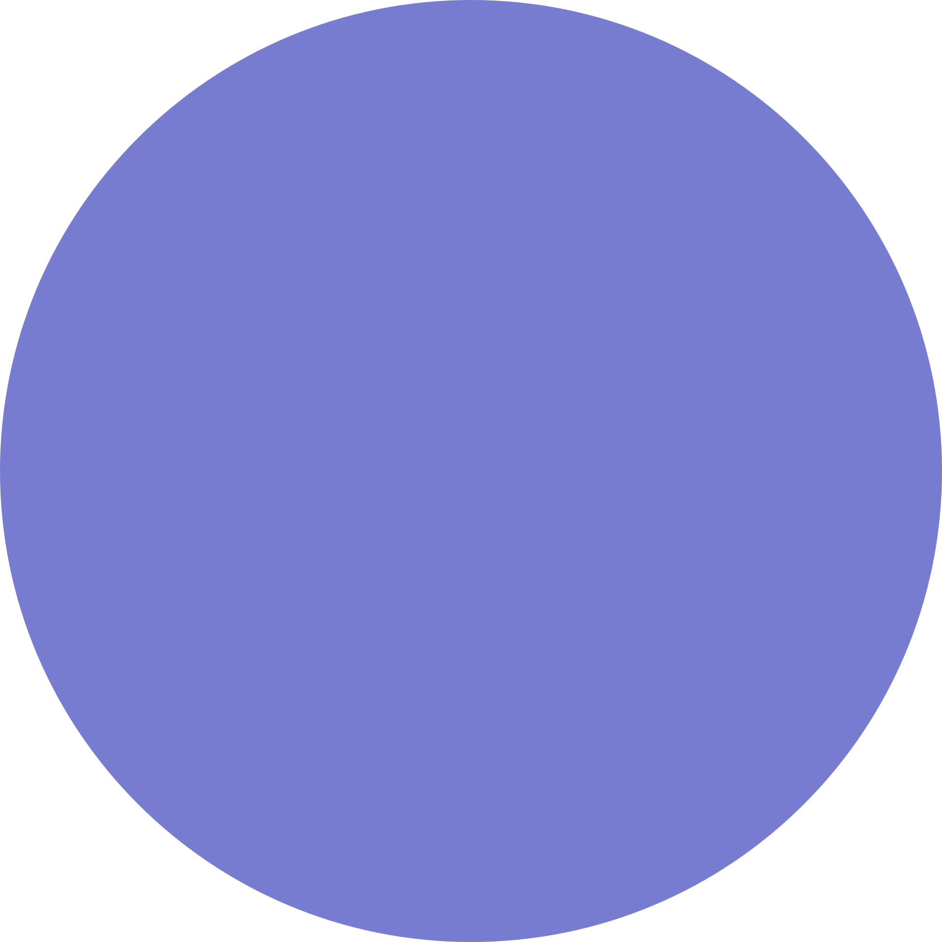

HTML
HTML stands for Hyper Text Markup Language. It is used to design web pages using a markup language. HTML is the combination of Hypertext and Markup language. Hypertext defines the link between the web pages.

Slide 3
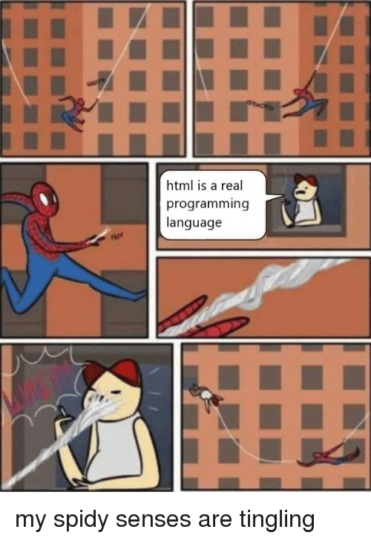

Slide 4



Tags in HTML
5
1
3
Image and Object Tags
Head Tag
Link Tags
Text Formatting Tag
Scripting and styling tags
2
4

Slide 5
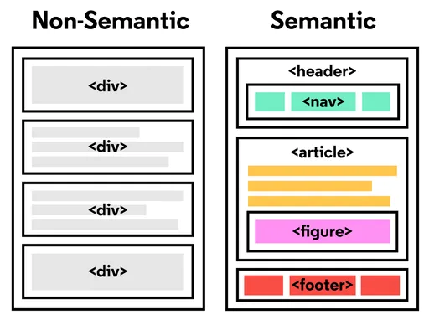

Semantic vs Non-semantic
A semantic element clearly describes its
meaning to both the browser and the
developer.
Non-semantic tags do not convey any
specific meaning or purpose in
particular.
Share upcoming upgrades or additional features
you have in mind for your product or service.
Give timelines too on when they can expect these.

Slide 6







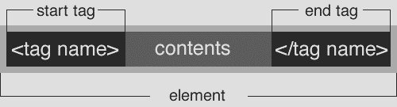






Elements and Tags
HTML uses predefined tags and elements which tell the browser how to properly display the content.
</>

Slide 7
Block
vs Inline Elements
Block-level Elements:
A block-level element always takes up the full width available(stretches out to the left and right as far as it can) Eg. <p>,<div>
Inline Elements :
An inline element only takes up as much width as necessary. Eg. <span>

Slide 8

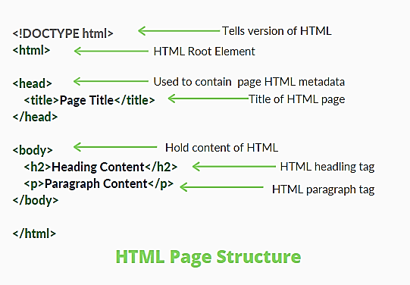




HTML page structure

Slide 9
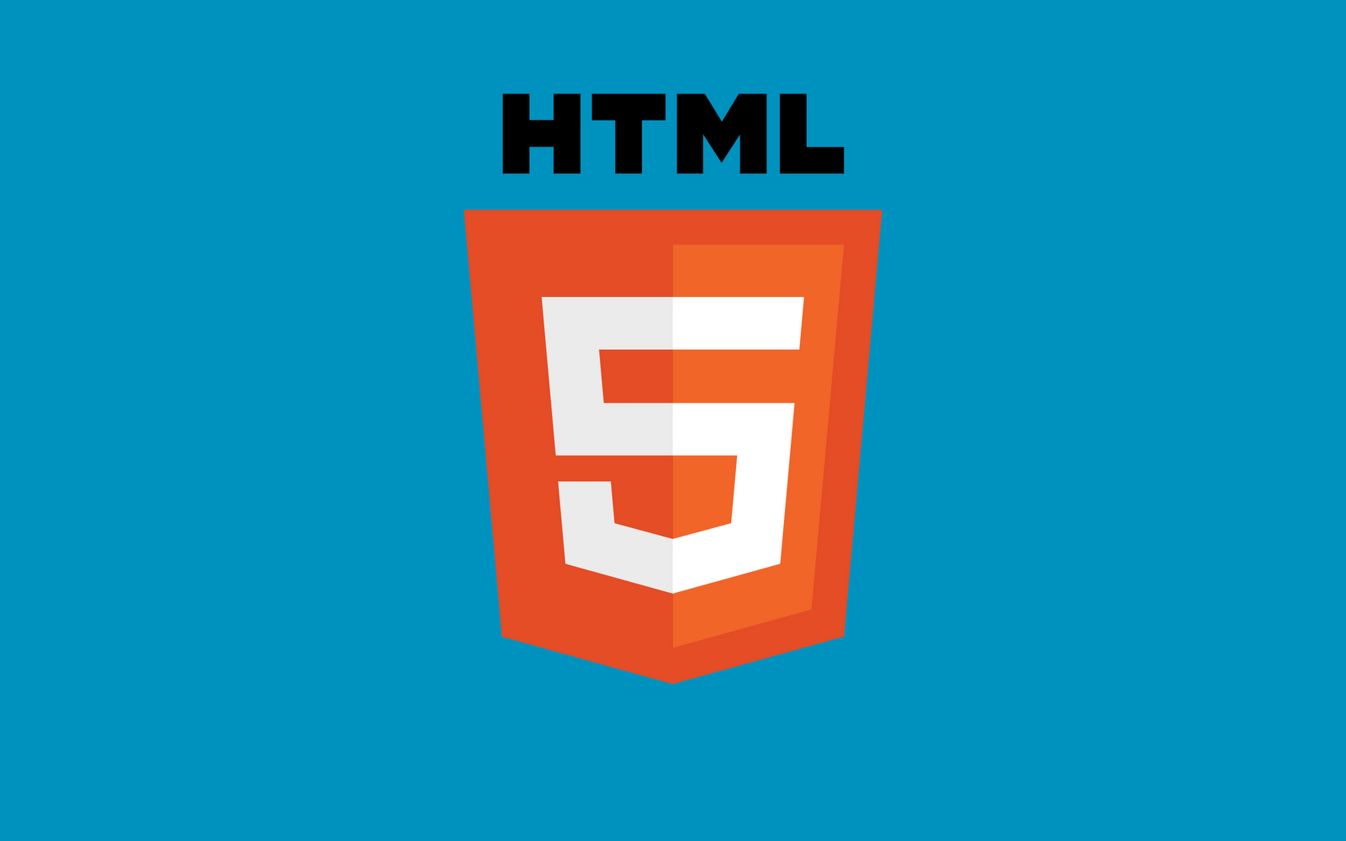


<DOCTYPE! html>: This is the document type declaration (not technically a tag). It declares a document as being an HTML document. The doctype declaration is not case-sensitive.
<html>: This is called the HTML root element. All other elements are contained within it.
<head>: The head tag contains the “behind the scenes” elements for a webpage. Elements within the head aren’t visible on the front-end of a webpage
<body>: The body tag is used to enclose all the visible content of a webpage. In other words, the body content is what the browser will show on the front-end.

Slide 10




Attributes
CLASS
ID
SPAN
DIV
The class is an attribute which specifies one or more class names for an HTML element.
The id attribute is a unique identifier that is used to specify the document.
The <span> HTML element is a generic inline container for phrasing content, which does not inherently represent anything.
The <div> tag is an empty container that is used to define a division or a section. It does not affect the content or layout and is used to group HTML elements to be styled with CSS or manipulated with scripts.

Slide 11


HTML DOM
DOM is a way to represent the webpage in a structured hierarchical way so that it will become easier for programmers and users to glide through the document. With DOM, we can easily access and manipulate tags, IDs, classes, Attributes, or Elements of HTML using commands or methods provided by the Document object

Slide 12

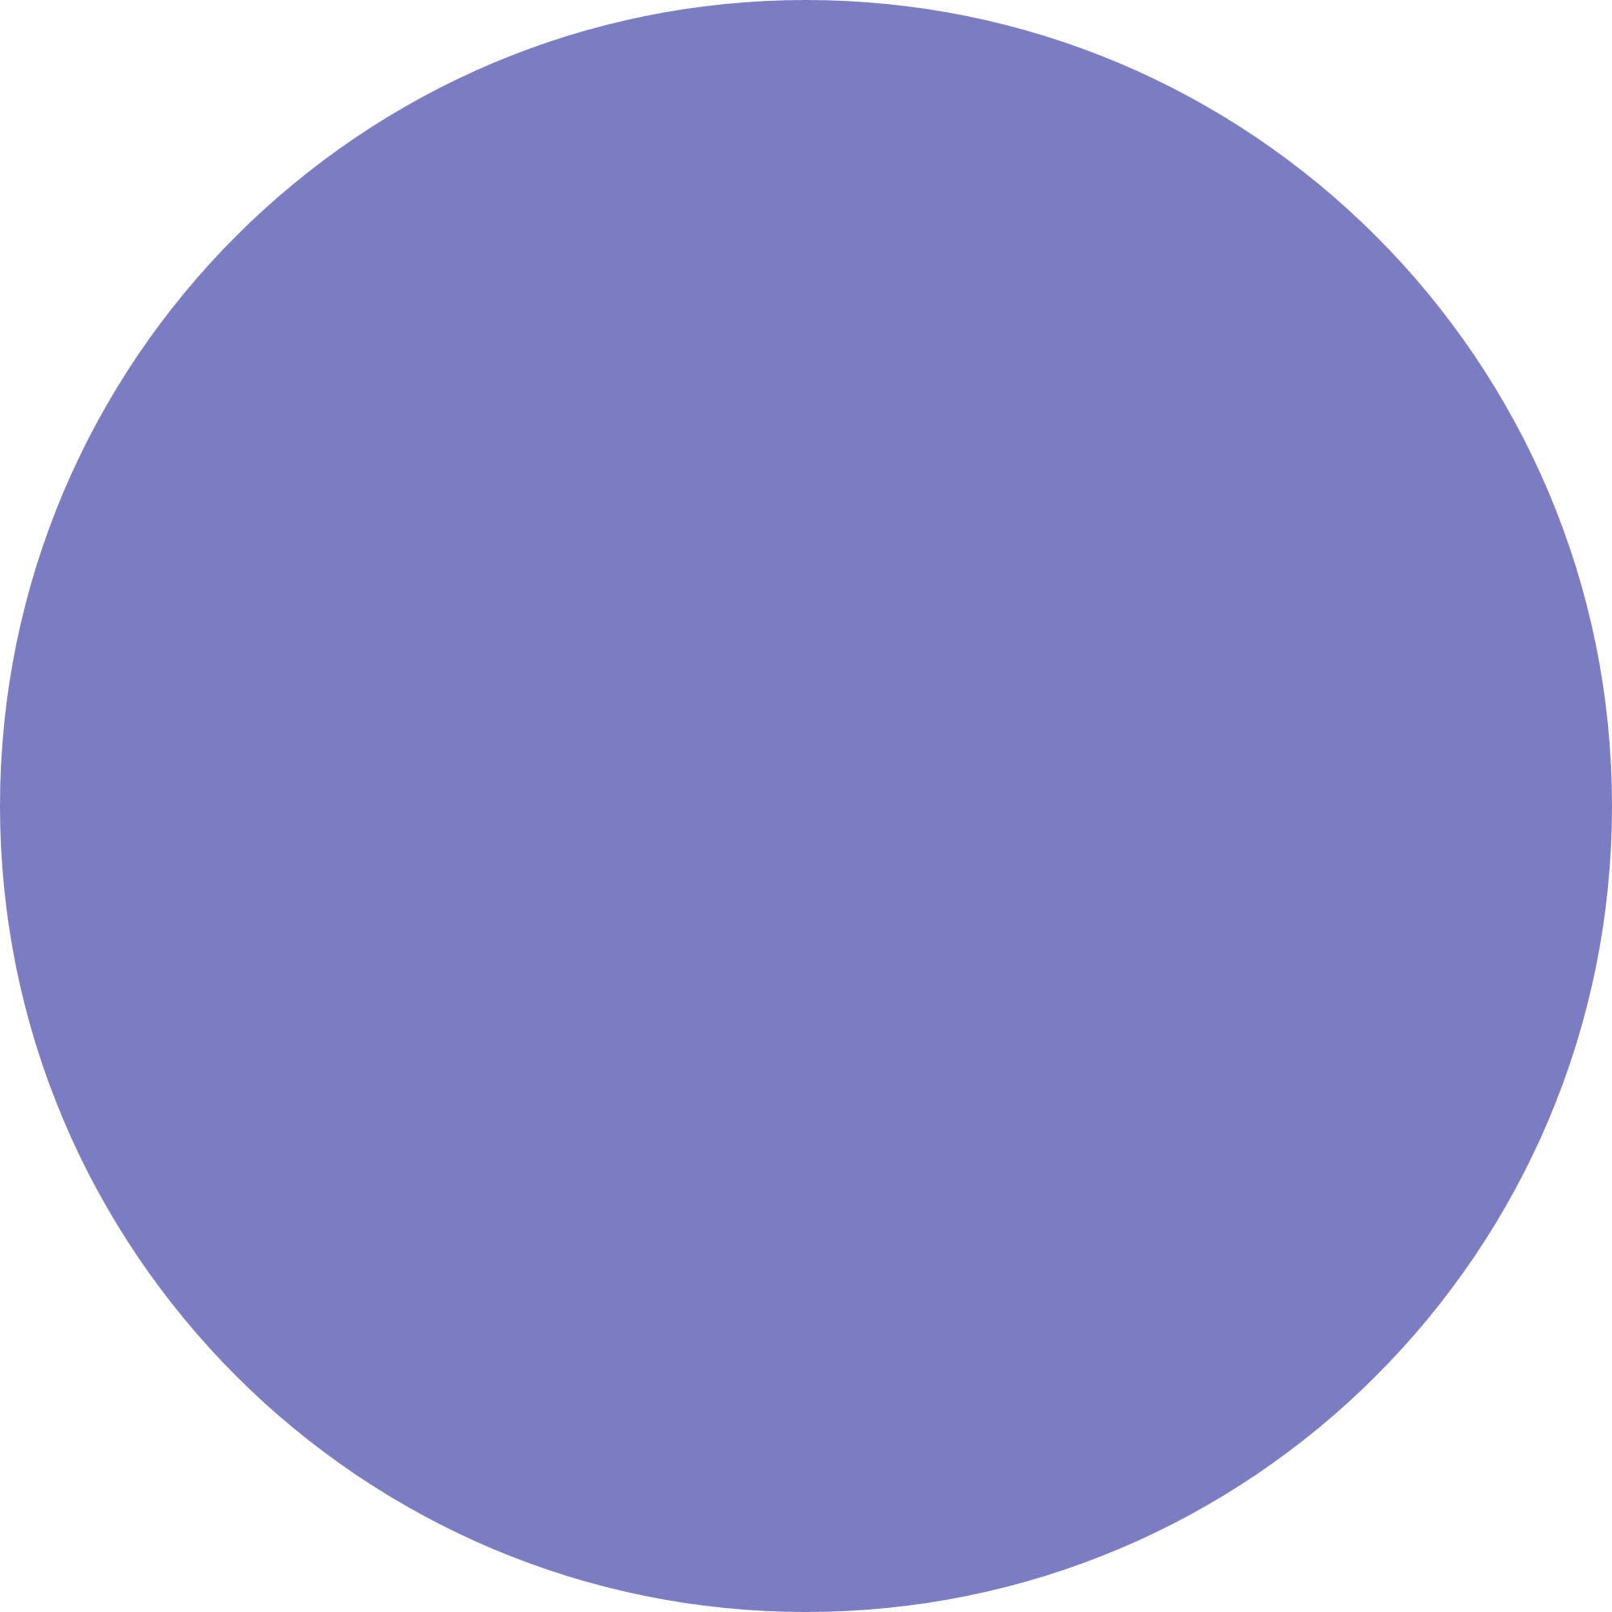
It is a simple markup language. Its implementation is easy.
Why learn HTML?
Helps in developing fundamentals about web programming.
It is platform-independent.
Advanced
It can be integrated with other languages like CSS, JavaScript, etc.
HTML is the foundation of web pages, is used for webpage development by structuring websites and web apps.

Slide 13


Did you know?
VS CODE ACTUALLY WORKS WITH 550K LINES OF HTML DOM.
The HTML NOSCRIPT elements defines a section of markup that acts as an alternate content for the users that have client-side scripting disabled.
The average web pages has around 71 divs. This number was computed after counting all the div elements (576,067,185) encountered within 8,021,323 million pages.

Slide 14
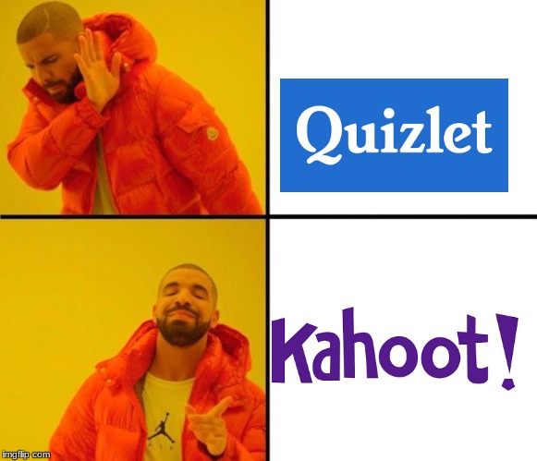
Lessgoooooooooo
TIME TO CODE!
Learning Web
Development
from the Internet.
Divyanshu is here
!!!!!

